Slide 1
THE NERVOUS SYSTEM
WORKSHEET INFORMATION

Slide 2
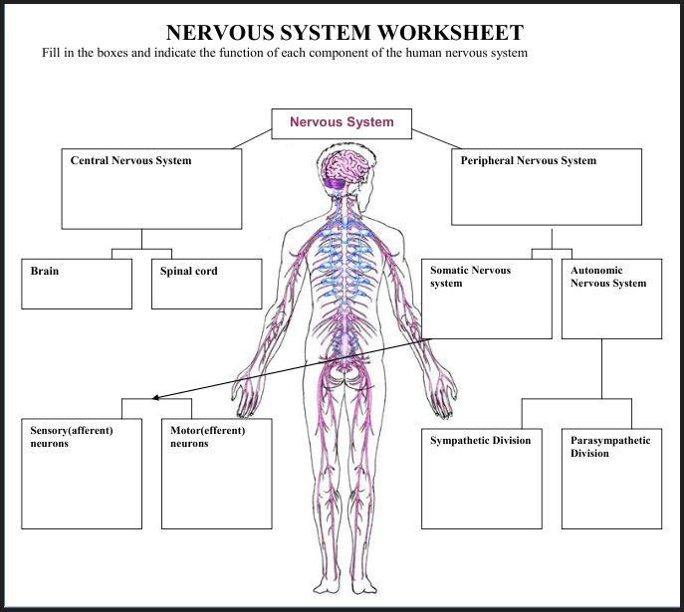

Slide 3
NERVOUS SYSTEM
Peripheral Nervous System
The peripheral nervous system carries messages to and from the central nervous system.
It sends information to the brain and carries out orders from the brain.
Sensory means that it sends the information coming from all your senses, touch, vision, hearing, taste, smell and position.
sends messages to motor nerve fibres to get the muscles to move the body.
Central Nervous System
The central nervous system (CNS) controls most functions of the body and mind.
It consists of two parts: the brain and the spinal cord.

Slide 4
CENTRAL NERVOUS SYSTEM
Brain
The brain controls what we think and feel, how we learn and remember, and the way we move and talk. ...
The rest of the nervous system is like a network that relays messages back and forth from the brain to different parts of the body.
It does this via the spinal cord, which runs from the brain down through the back.
Spinal Cord
The spinal cord, along with the brain, makes up the central nervous system. ...
Its three major roles are to relay messages from the brain to different parts of the body, to perform an action, to pass along messages from sensory receptors to the brain, and to coordinate reflexes that are managed by the spinal cord

Slide 5
PERIPHERAL NERVOUS SYSTEM Your peripheral nervous system is made up of two parts: the somatic nervous system and the autonomic nervous system.
Somatic Nervous System
Major functions of the somatic nervous system include voluntary movement of the muscles and organs and reflex movements.
In the process of voluntary movement, sensory neurons carry impulses to the brain and the spinal cord
Autonomic Nervous System
The autonomic nervous system is a control system that acts largely unconsciously and regulates bodily functions, such as the heart rate, digestion, respiratory rate, pupillary response, urination, and sexual arousal.
This system is the primary mechanism in control of the fight-or-flight response.

Slide 6
SOMATIC NERVOUS SYSTEM
Sensory Afferent Neurons
Afferent neurons are sensory neurons that carry nerve impulses from sensory stimuli towards the central nervous system and brain.
Motor efferent Neurons
Efferent neurons are motor neurons that carry neural impulses away from the central nervous system and towards muscles to cause movement.

Slide 7
AUTONOMIC NERVOUS SYSTEM
Sympathetic Division
The sympathetic nervous system directs the body's rapid involuntary response to dangerous or stressful situations.
A flash flood of hormones boosts the body's alertness and heart rate, sending extra blood to the muscles.
Parasympathetic division
The parasympathetic nervous system is responsible for the body's rest and digestion response when the body is relaxed, resting, or feeding. It basically undoes the work of sympathetic division after a stressful situation.
The parasympathetic nervous system decreases respiration and heart rate and increases digestion.

